Slide 1
The Molecular Basis of Inheritance
Chapter 16

Slide 2
Life’s Operating Instructions
In 1953, James Watson and Francis Crick introduced a double-helical model for the structure of deoxyribonucleic acid, or DNA
Hereditary information is encoded in DNA and reproduced in all cells of the body
This DNA program directs the development of biochemical, anatomical, physiological, and (to some extent) behavioral traits

Slide 3
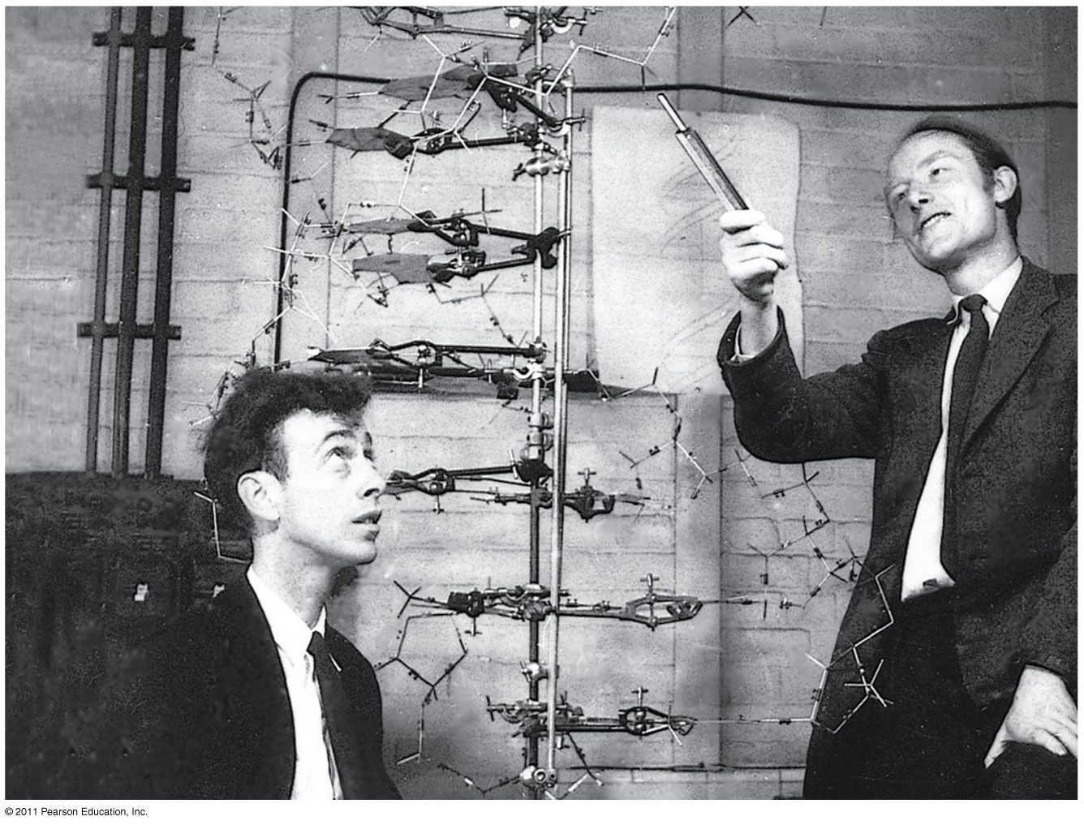
Life’s Operating Instructions

Slide 4
The Search for the Genetic Material: Scientific Inquiry
The role of DNA in heredity was first discovered by studying bacteria and the viruses that infect them
The discovery of the genetic role of DNA began with research by Frederick Griffith in 1928
Griffith worked with two strains of a bacterium, one pathogenic and one harmless

Slide 5
The Search for the Genetic Material: Scientific Inquiry
When he mixed heat-killed remains of the pathogenic strain with living cells of the harmless strain, some living cells became pathogenic
He called this phenomenon transformation, now defined as a change in genotype and phenotype due to assimilation of foreign DNA

Slide 6
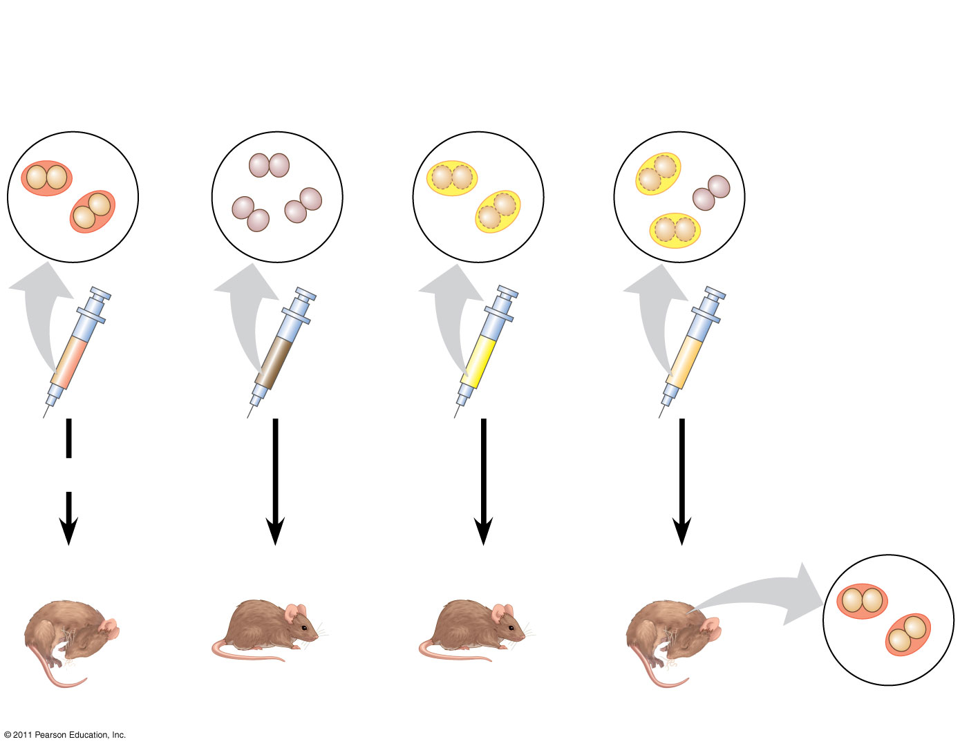
Can a genetic trait be transferred between different bacterial strains?
Mixture of
heat-killed
S cells and
living R cells
Living S cells
(control)
Living R cells
(control)
Heat-killed
S cells
(control)
Mouse dies
Mouse healthy
Mouse healthy
Mouse dies
Living S cells

Slide 7
Evidence That Viral DNA Can Program Cells
More evidence for DNA as the genetic material came from studies of viruses that infect bacteria
Such viruses, called bacteriophages (or phages), are widely used in molecular genetics research

Slide 8
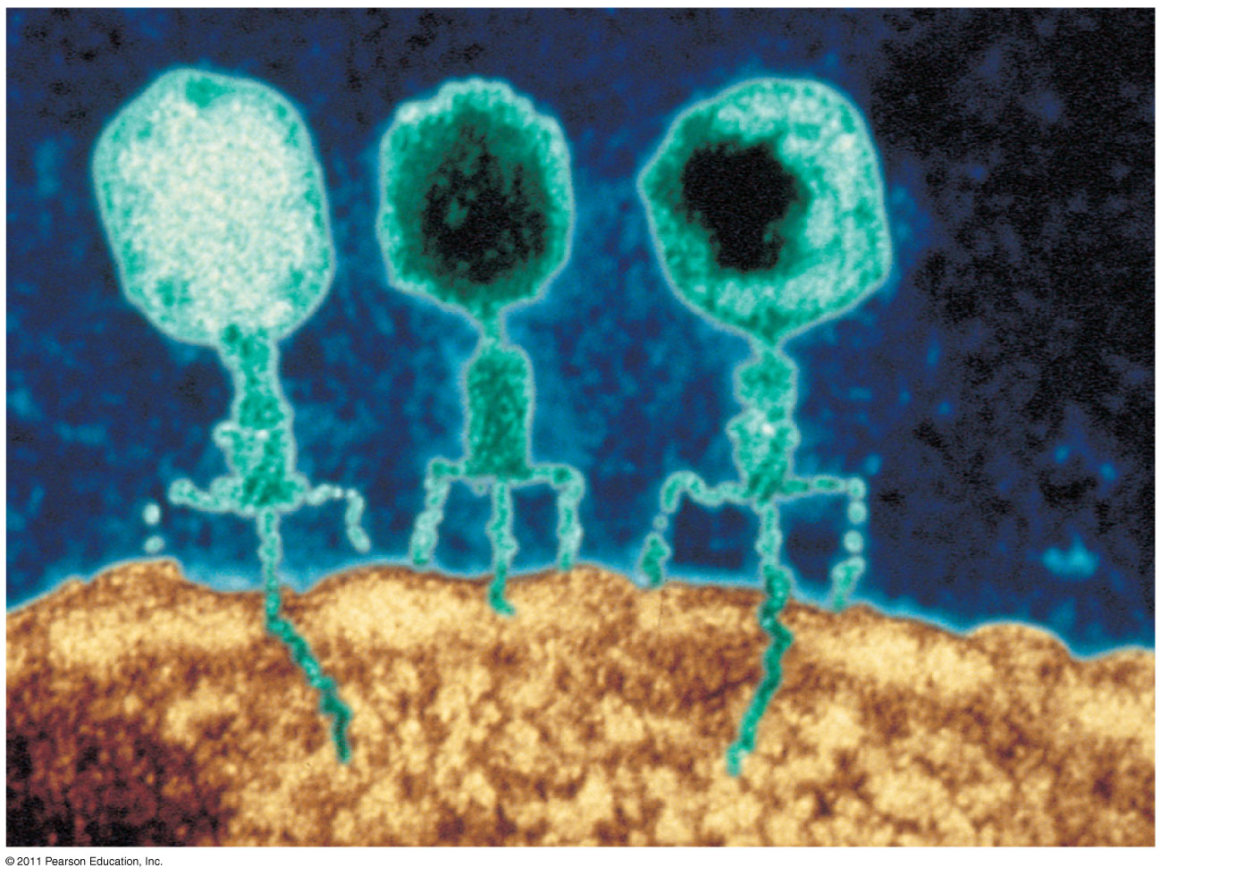
Evidence That Viral DNA Can Program Cells
Bacterial
cell

Slide 9
Building a Structural Model of DNA: Scientific Inquiry
After DNA was accepted as the genetic material, the challenge was to determine how its structure accounts for its role in heredity
Maurice Wilkins and Rosalind Franklin were using a technique called X-ray crystallography to study molecular structure
Franklin produced a picture of the DNA molecule using this technique

Slide 10
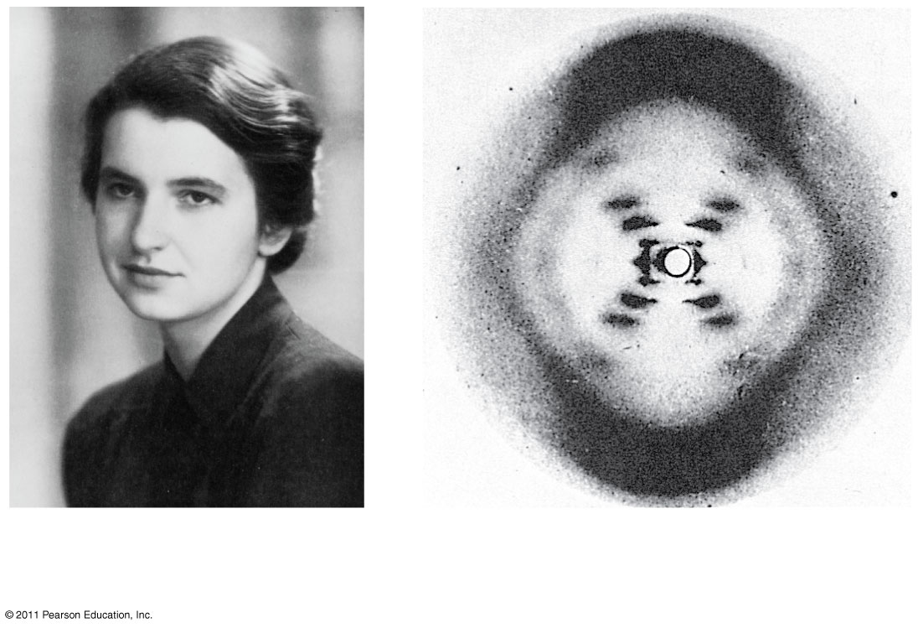
Building a Structural Model of DNA: Scientific Inquiry
Rosalind Franklin
Franklin’s X-ray diffraction
photograph of DNA

Slide 11
Building a Structural Model of DNA: Scientific Inquiry
Franklin’s X-ray crystallographic images of DNA enabled Watson to deduce that DNA was helical
The X-ray images also enabled Watson to deduce the width of the helix and the spacing of the nitrogenous bases
The pattern in the photo suggested that the DNA molecule was made up of two strands, forming a double helix

Slide 12
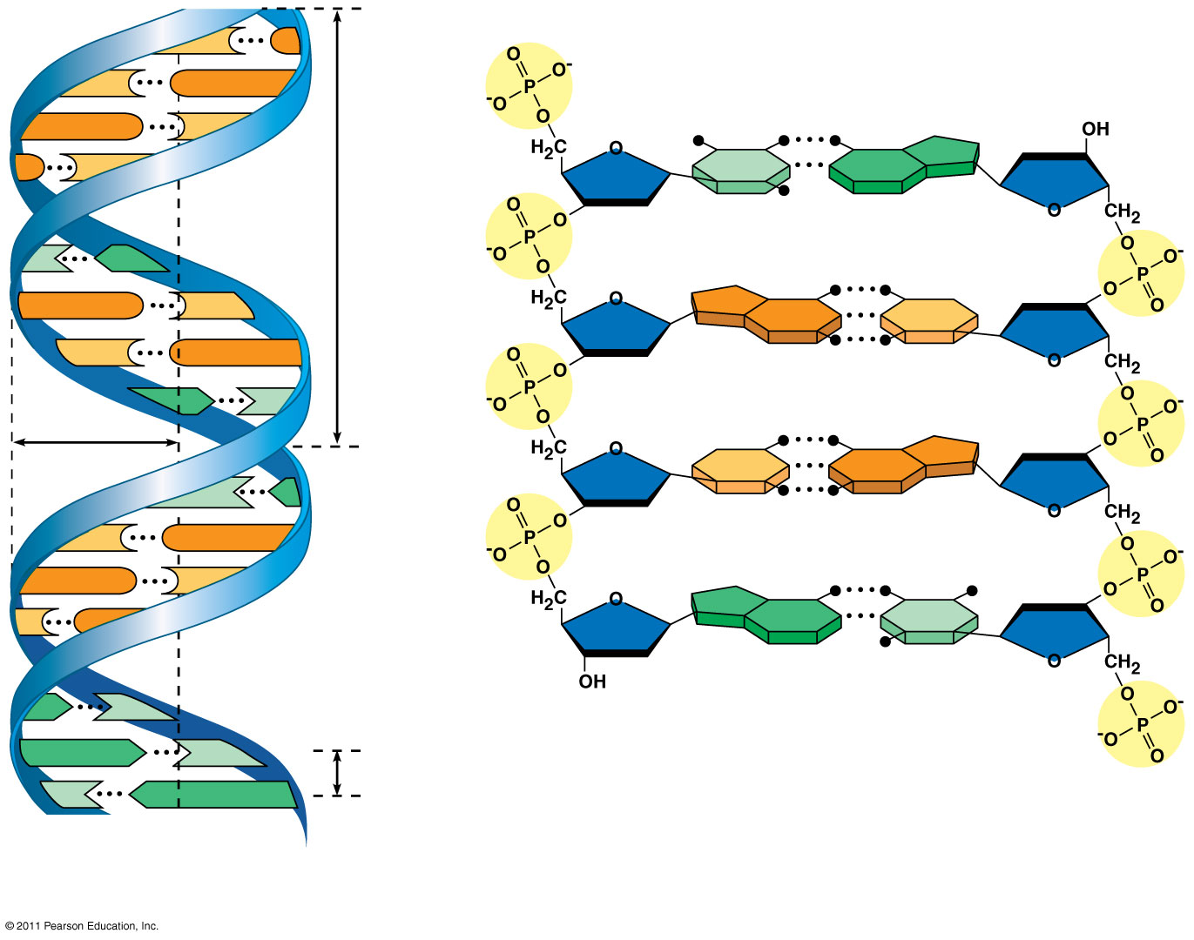
Building a Structural Model of DNA: Scientific Inquiry

Slide 13
Building a Structural Model of DNA: Scientific Inquiry
Watson and Crick built models of a double helix to conform to the X-rays and chemistry of DNA
Franklin had concluded that there were two outer sugar-phosphate backbones, with the nitrogenous bases paired in the molecule’s interior
Watson built a model in which the backbones were antiparallel (their subunits run in opposite directions)

Slide 14
Building a Structural Model of DNA: Scientific Inquiry
Watson and Crick reasoned that the pairing was specific, dictated by the base structures
They determined that adenine (A) paired only with thymine (T), and guanine (G) paired only with cytosine (C)
The Watson-Crick model explains: in any organism the amount of A = T, and the amount of G = C

Slide 15
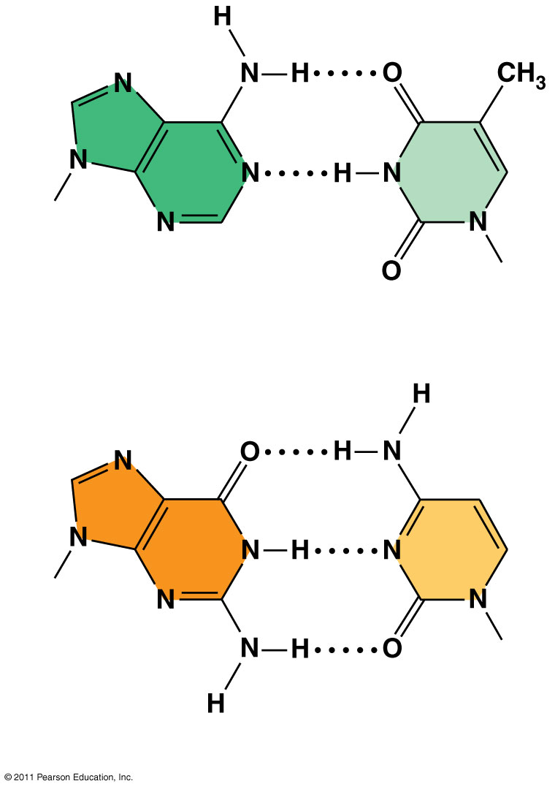
Building a Structural Model of DNA: Scientific Inquiry
Sugar
Sugar
Adenine (A
Thymine (T)
Sugar
Sugar
Guanine (G
Cytosine (C)

Slide 16
The Basic Principle: Base Pairing to a Template Strand
Since the two strands of DNA are complementary, each strand acts as a template for building a new strand in replication
In DNA replication, the parent molecule unwinds, and two new daughter strands are built based on base-pairing rules

Slide 17
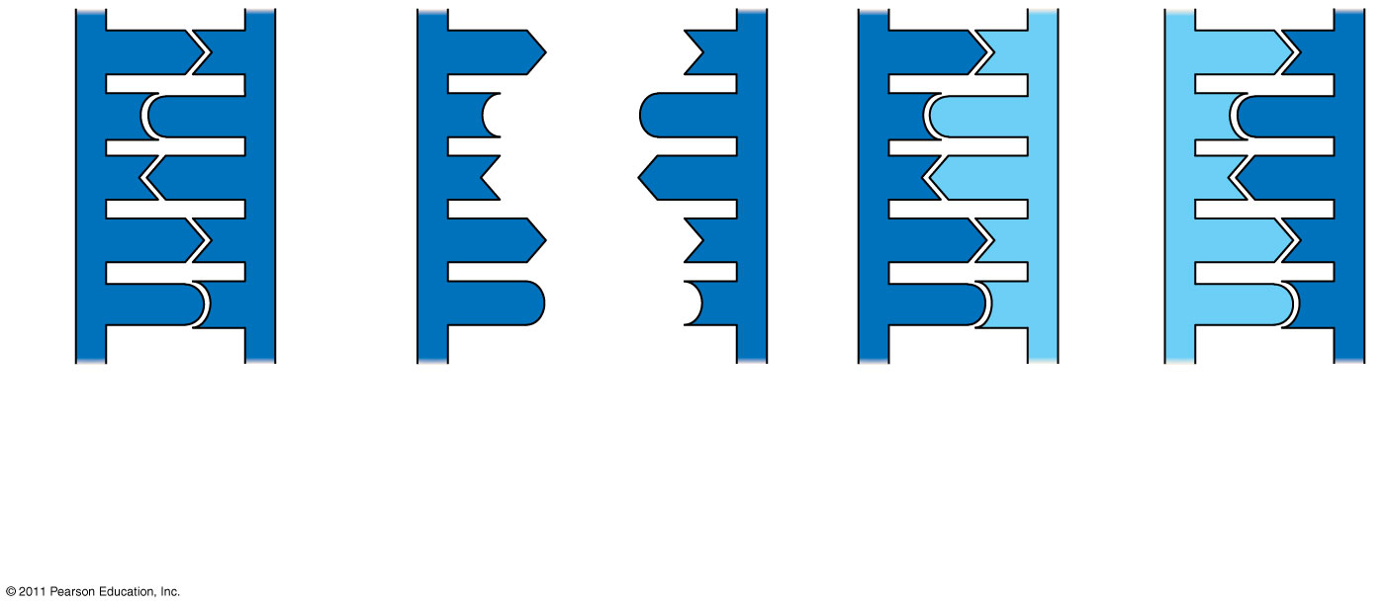
The Basic Principle: Base Pairing to a Template Strand
Parent molecule
Separation of
strands
“Daughter” DNA molecules,
each consisting of one
parental strand and one
new strand

Slide 18
The Basic Principle: Base Pairing to a Template Strand
Watson and Crick’s semiconservative model of replication predicts that when a double helix replicates, each daughter molecule will have one old strand (derived or “conserved” from the parent molecule) and one newly made strand
Competing models were the conservative model (the two parent strands rejoin) and the dispersive model (each strand is a mix of old and new)

Slide 19
DNA Replication: A Closer Look
The copying of DNA is remarkable in its speed and accuracy
More than a dozen enzymes and other proteins participate in DNA replication

Slide 20
Getting Started
Replication begins at particular sites called origins of replication, where the two DNA strands are separated, opening up a replication “bubble”
A eukaryotic chromosome may have hundreds or even thousands of origins of replication
Replication proceeds in both directions from each origin, until the entire molecule is copied

Slide 21
Getting Started
At the end of each replication bubble is a replication fork, a Y-shaped region where new DNA strands are elongating
Helicases are enzymes that untwist the double helix at the replication forks
Single-strand binding proteins bind to and stabilize single-stranded DNA
Topoisomerase corrects “overwinding” ahead of replication forks by breaking, swiveling, and rejoining DNA strands

Slide 22
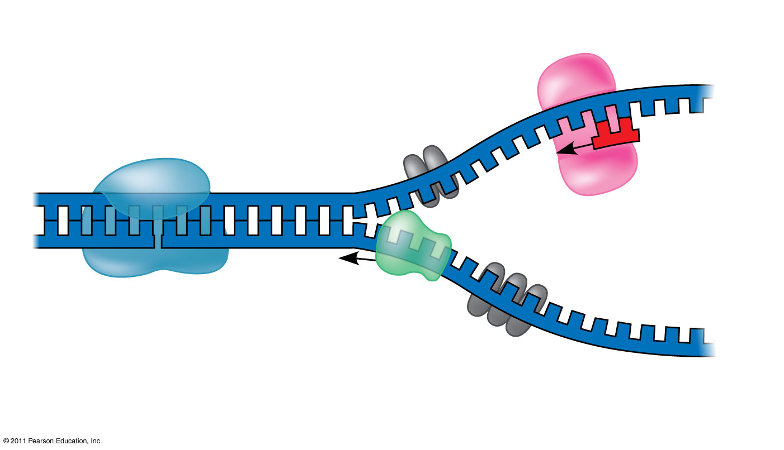
Getting Started
3′
Topoisomerase
5′
5′
3′
3′
Helicase
Single-strand binding
proteins
5′

Slide 23
Getting Started
DNA polymerases cannot initiate synthesis of a polynucleotide; they can only add nucleotides to the 3′ end
The initial nucleotide strand is a short RNA primer
The primer is short (5–10 nucleotides long), and the 3′ end serves as the starting point for the new DNA strand

Slide 24
Synthesizing a New DNA Strand
Enzymes called DNA polymerases catalyze the elongation of new DNA at a replication fork
Most DNA polymerases require a primer and a DNA template strand
The rate of elongation is about 500 nucleotides per second in bacteria and 50 per second in human cells

Slide 25
Antiparallel Elongation
The antiparallel structure of the double helix affects replication
DNA polymerases add nucleotides only to the free 3′ end of a growing strand; therefore, a new DNA strand can elongate only in the 5′ to 3′ direction

Slide 26
Proofreading and Repairing DNA
DNA polymerases proofread newly made DNA, replacing any incorrect nucleotides
In mismatch repair of DNA, repair enzymes correct errors in base pairing
DNA can be damaged by exposure to harmful chemical or physical agents such as cigarette smoke and X-rays; it can also undergo spontaneous changes
In nucleotide excision repair, a nuclease cuts out and replaces damaged stretches of DNA

Slide 27
Evolutionary Significance of Altered DNA Nucleotides
Error rate after proofreading repair is low but not zero
Sequence changes may become permanent and can be passed on to the next generation
These changes (mutations) are the source of the genetic variation upon which natural selection operates

Slide 28
A chromosome consists of a DNA molecule packed together with proteins
The bacterial chromosome is a double-stranded, circular DNA molecule associated with a small amount of protein
Eukaryotic chromosomes have linear DNA molecules associated with a large amount of protein
In a bacterium, the DNA is “supercoiled” and found in a region of the cell called the nucleoid

Slide 29
A chromosome consists of a DNA molecule packed together with proteins
Chromatin, a complex of DNA and protein, is found in the nucleus of eukaryotic cells
Chromosomes fit into the nucleus through an elaborate, multilevel system of packing

Slide 30
A chromosome consists of a DNA molecule packed together with proteins
Chromatin undergoes changes in packing during the cell cycle
At interphase, some chromatin is organized into a 10-nm fiber, but much is compacted into a 30-nm fiber, through folding and looping
Though interphase chromosomes are not highly condensed, they still occupy specific restricted regions in the nucleus

Slide 31
A chromosome consists of a DNA molecule packed together with proteins
Most chromatin is loosely packed in the nucleus during interphase and condenses prior to mitosis
Loosely packed chromatin is called euchromatin
During interphase a few regions of chromatin (centromeres and telomeres) are highly condensed into heterochromatin
Dense packing of the heterochromatin makes it difficult for the cell to express genetic information coded in these regions

Slide 32
The END

